Slide 1
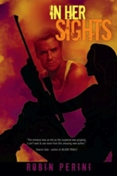
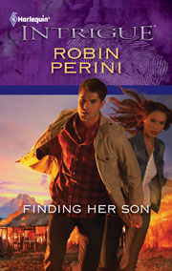
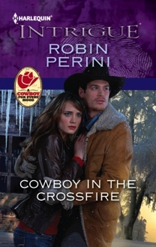
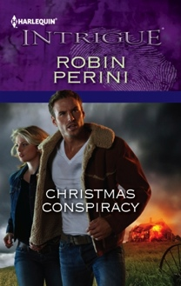
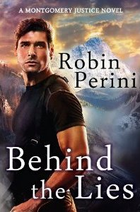
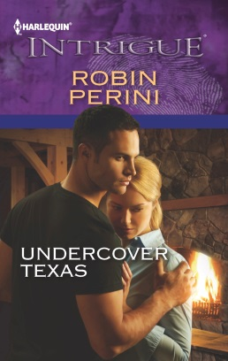
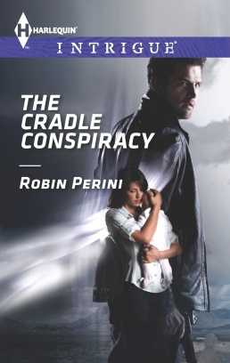
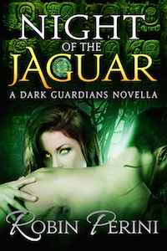
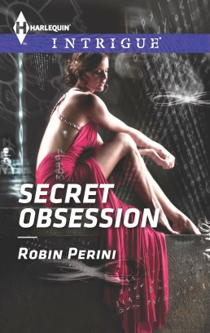
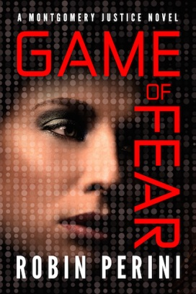
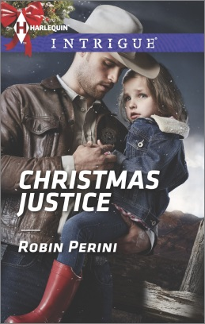
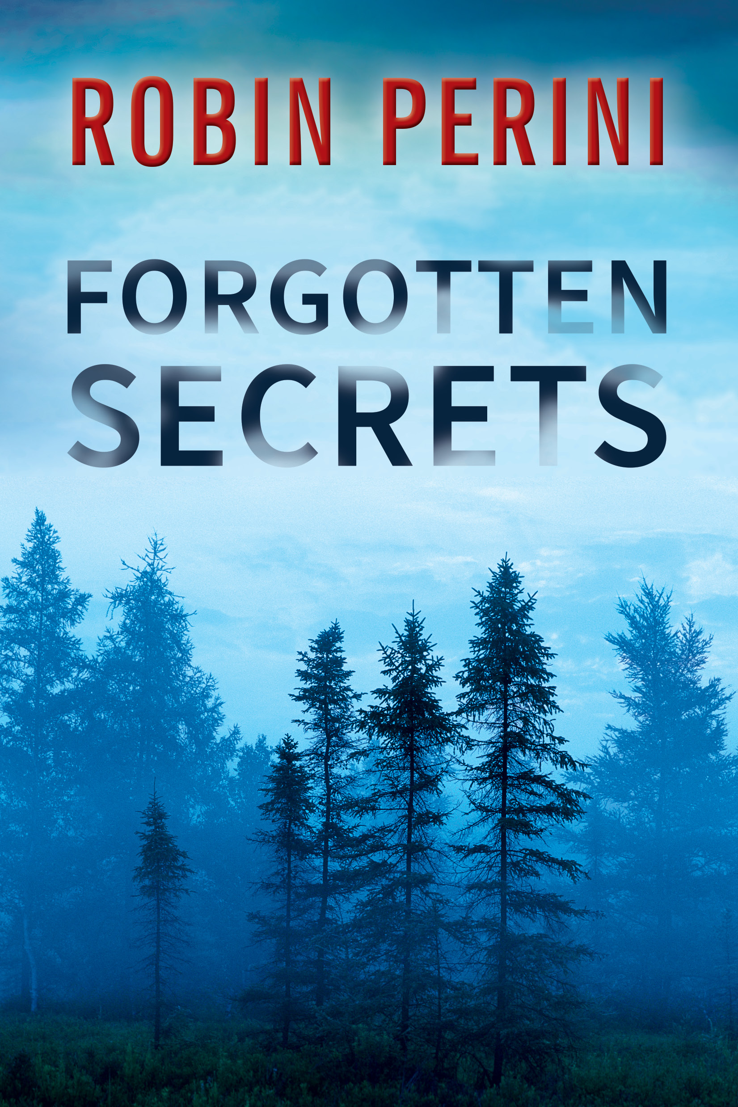
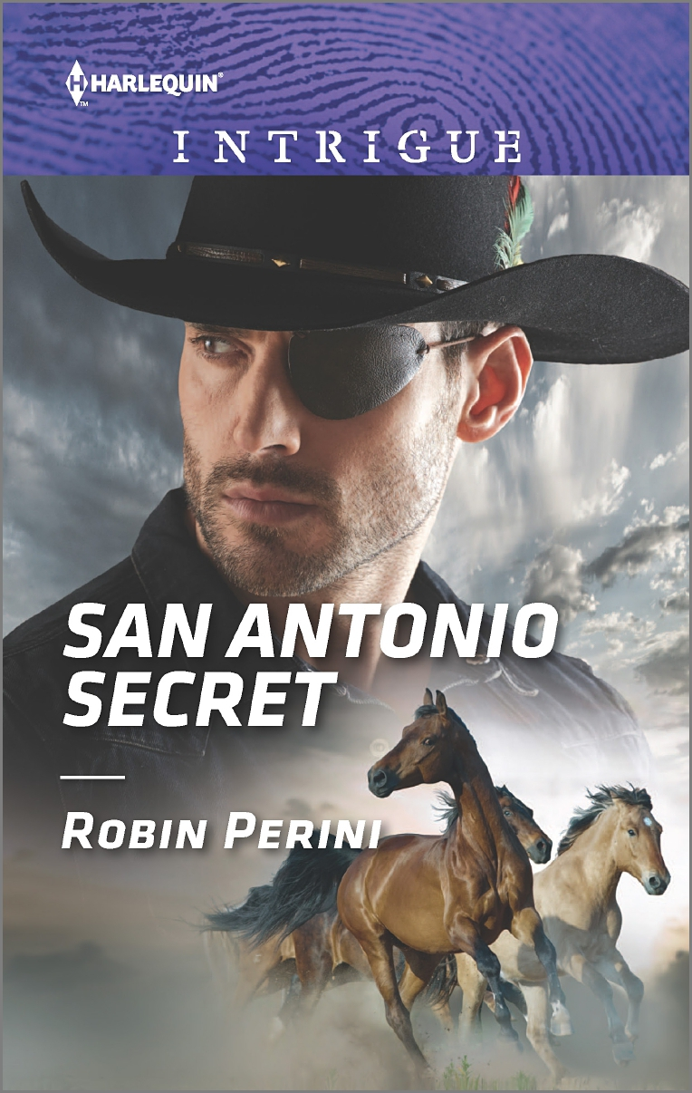
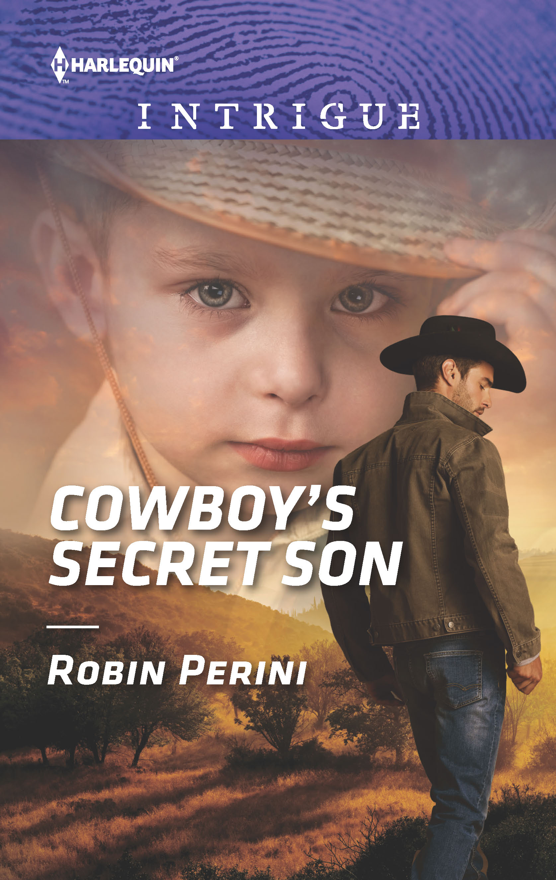
How to Transform a Good Book
Into a Great Book
Robin Perini
Romance Writers of America, July 19, 2018
Notes:
Good morning, everyone.
Wow. Thanks for coming. I know it’s early. Thank you’s to everyone!
To start—I have a book here.
Please put your card (or a piece of paper with your name on it) in the bucket. I’ll draw for a winner at the end of the workshop. (It’s a bribe—you must be present to win).
As usual, we have a lot to do, and a little time to do it. So let’s get started.
The title of this workshop is:
But before we get started, I have something important to say….NEXT SLIDE.

Slide 2

Take What You Want
…and Leave the Rest
What a writer … "wants is a set of rules on what to do and what not to do in writing fiction….when one begins to be persuaded that certain things must never be done in fiction and certain other things must always be done, one has entered the first stage of aesthetic arthritis, the disease that ends in pedantic rigidity and the atrophy of intuition.“
— John Gardner, The Art of Fiction
Notes:
I’m giving you my standard disclaimer…..
Let’s start with a quote from John Gardner.
The first thing I want to say about any talk on writing, and mine especially, is take what you want and leave the rest. Most of you have an instinct for storytelling or you wouldn’t be here. It’s a gift. You’ve studied craft, you’ve studied character, conflict and plot and now you’ve got words on paper. Many of you will have already accomplished what's in this talk organically and by instinct. But for times when a book's in trouble or when you're up against the wall--that's when analysis can be a lifesaver.
If you go to a workshop, any workshop, and they tell you that their way is the ONLY way to do this…Walk, don’t run to the nearest exist.
There are as many ways to write, as there are writers, take what you want and leave the rest.
Also, I’m a certifiable plotter. For the most part. So, if you’re not, that’s fine. I hope the knowledge gained here will give you some insight at your pantsting away.
YOU ARE DOING THIS BY INSTICT!!!!

Slide 3


How do you write?
Pantsters, Plotters and Planners
What we have in common: Elements of Story
  Character
  Plot
  Theme
  Voice

Slide 4

Non-Craft

Slide 5
Non-Craft
  Life-long learning (you, your critique group) – challenge yourself.
  Discover YOUR process
    Strengths and Weaknesses
      Plot, Character, etc.
    Robin’s journey
          Discovering Story Magic
          W-Diagram
          Alexandra Sokoloff
Notes:
Non-craft
Life-long learning (you, your critique group) – challenge yourself.
Discover your process
Be willing to change/expand/adjusts…but know your strengths and weaknesses
Planner, Plotter, Pantster
Creative Goal Setting
Do your strengths fit your genre?
What is your kind of book?
Identify an author whose career you want to emulate…
Set goals and write them down, then evaluate and re-evaluate. (SMART – SPECIFIC, MEASURABLE, ACHIEVABLE, REALISTIC, TIME-BOUND)
Make writing a priority…decide what's important.
Write regularly…discover how fast you can write a book, and what it takes.
After you complete one book, take a short break then start another
Elements that I already knew: Deep Character, Turning Points, Romantic Conflict

Slide 6

Uncover YOUR Emotional Cues
(Laura Baker – www.fearlesswriter.com)
Authentic writing comes from authentic emotion
  Emotions connect character and structure
  Embrace the emotions that ‘speak’ to you
  Write what you ‘know’
List your 3 most powerful childhood memories
  Define three key emotions in each
  memory
EXERCISE!
Notes:
Uncover YOUR EMOTIONAL CUES – LAURA BAKER…
We’ll be using this information several times during the workshop....

Slide 7
What do you Look for in a Read?
Name two authors whose work you love!
  What are the key emotions they explore?
    Write down 2 for each author if possible
Identify your favorite ‘keeper book’
  Who is your favorite character in that book?
  Identify 3 key emotions of that person.
EXERCISE!

Slide 8
Your Writing
Identify the book that was easiest for you to finish? (If you haven’t finished a book yet, identify another ‘keeper’; or use the book that you’ve written on the most).)
  List 3 prominent characteristics of this book
  Identify the most compelling character
  List 3 prominent characteristics of this character
COMPARE THE LISTS
OF EMOTIONS
EXERCISE!

Slide 9
Aha Moment
Is there a common thread?
  Similarities?
  Opposites?
Consider the book you have been UNABLE or STRUGGLED to finish?
EXERCISE!

Slide 10
Take Away
Embrace your emotional cues
Leverage the power of your emotions
Consider merging this emotional identity with your author brand

Slide 11
Exploit Tension and Suspense
(Not the Dead Body Kind)

Slide 12
Suspense - Definition
Keeps the reader turning the pages until 4 AM
  Builds apprehension and anticipation in the minds of your readers
  Think: Worry equals suspense
  Always have an unanswered question in the reader’s mind (What happens next?)
Suspense builds as danger approaches and we care!

Slide 13
Keep Them Reading!
If you don’t hook your readers, they won’t get into the story.
If you don’t drive the story forward by making readers worry about your main character, they won’t have a reason to keep reading.
The basic narrative fuel is always the slow unveiling of the final answer. (Lee Child) – if you want to build suspense, postpone it
  Suspense happens in the moments between the promise of something dreadful and its arrival.

Slide 14
Hook the Reader
Beginning Hooks (chapters and scenes)
  Openings are critical
Ending Hooks (first page, third page, scene, chapter, book):
  Threat of Danger (Emotional or Physical)
  Shock Factor
  Ending Question
  Ending Prediction
Let’s look at some hooks!
Resource: Mary Buckham’s Activating Hooks

Slide 15
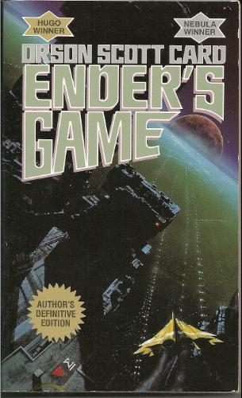
Dialogue Only
Ender’s Game by Orson Scott Card
"I've watched through his eyes, I've listened
through his ears, and I tell you he's the one. Or at
least as close as we're going to get."
"That's what you said about the brother."
"The brother tested out impossible. For other
reasons. Nothing to do with his ability."
"Same with the sister. And there are doubts about him. He's too malleable. Too willing to submerge himself in someone else's will."
"Not if the other person is his enemy."
"So what do we do? Surround him with enemies all the time?"
"If we have to."
"I thought you said you liked the kid."
"If the buggers get him, they'll make me look like his favorite uncle."
"All right. We're saving the world, after all. Take him."
Type of Hook – Threat of Danger, Shock Factor

Slide 16
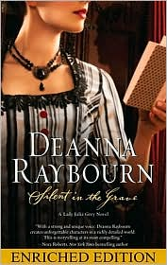
First person
Silent in the Grave by Deanna Raybourn
  London 1886
  Other sins only speak; murder shrieks out.—John Webster, The Duchess of Malfi
To say that I met Nicholas Brisbane over my husband's dead body is not entirely accurate. Edward, it should be noted, was still twitching upon the floor.
I stared at him, not quite taking in the fact that he had just collapsed at my feet. He lay, curled like a question mark, his evening suit ink-black against the white marble of the floor. He was writhing, his fingers knotted.
I leaned as close to him as my corset would permit.
"Edward, we have guests. Do get up. If this is some sort of silly prank—"
"He is not jesting, my lady. He is convulsing."
Type of Hook – Shock Factor

Slide 17
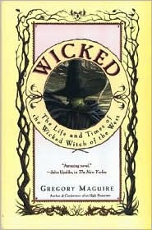
Omnicient
Wicked: The life and Times of the Wicked Witch of the west by Gregory Maguire
  On the Yellow Brick Road
A mile above Oz, the Witch balanced on the wind's forward edge, as if she were a green fleck of the land itself, flung up and sent wheeling away by the turbulent air. White and purple summer thunderheads mounded around her. Below, the Yellow Brick Road looped back on itself, like a relaxed noose. Though winter storms and the crowbars of agitators had torn up the road, still it led, relentlessly, to the Emerald City. The Witch could see the companions trudging along, maneuvering around the buckled sections, skirting trenches, skipping when the way was clear. They seemed oblivious of their fate. But it was not up to the Witch to enlighten them.
Type of Hook – Ending Prediction

Slide 18

Third Person
Game of Fear by Robin Perini (2014)
“You’ve figured it out already, haven’t you, Zach?”
The excrement-flinging fan was winding up now.
“Spell it out for me. I’m feeling a little slow.”
Whitney paled, then raised her chin. “Somehow I doubt that.” She clicked her seat belt into place. “I’m your half sister,” she said, her tone professional. “And before you ask, I’ll tell you everything I know. Your parents separated for a short while. Your father got drunk, took my mother to bed one time, and I’m the result. Now that that little turd has been dropped into the punch bowl, we have more important things to worry about. Can we talk about Winslow?”
Type of Hook – Shock Factor, Ending Question

Slide 19
Is this a hook?
It was a cold and rainy day. Lyssa Cafferty walked down the street going home for the evening.

Slide 20
Suspense Through Words
“Don’t tell me the moon is shining; show me the glint of light on broken glass.” –Anton Chekhov
“The difference between the right word and the almost right word is the difference between lightning and a lightning bug.” – Mark Twain

Slide 21
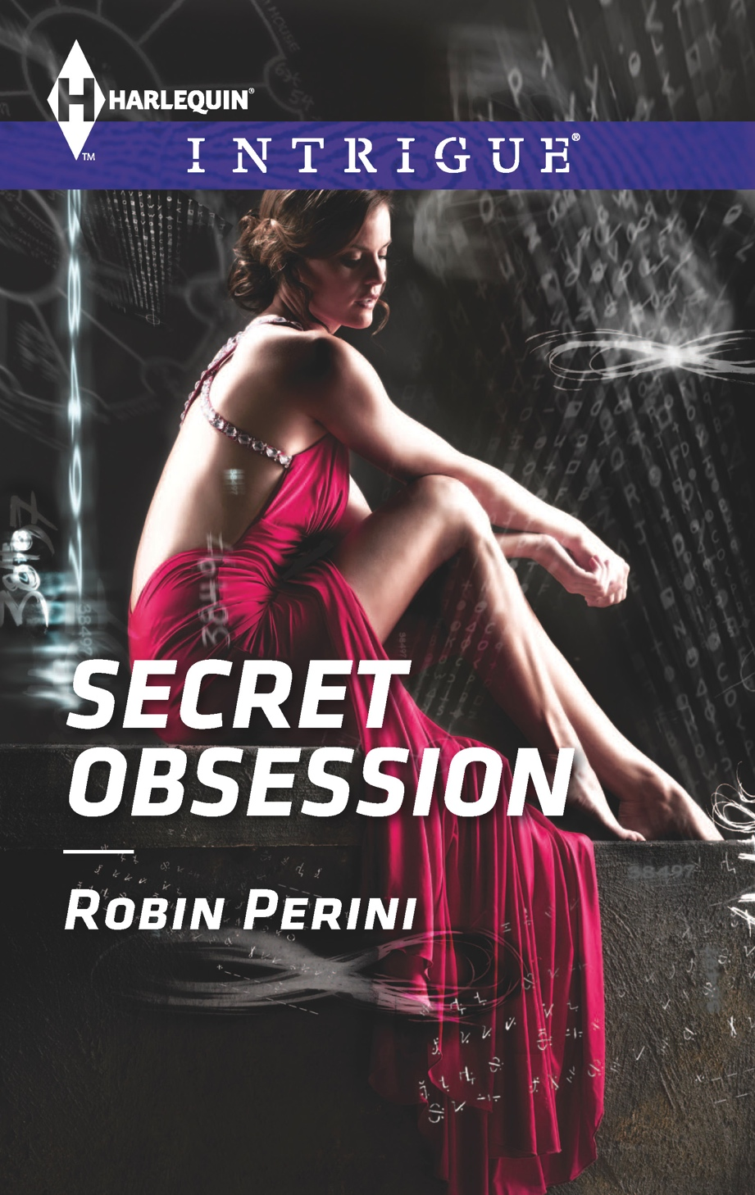
Secret Obsession (August 2014)
Specificity
Power Words
Imagery
Compelling
Dialogue
End Hooks
Deep POV
The sting of frozen rain pricked
Lyssa Cafferty’s cheeks, another attack she
couldn’t prevent. She hurried from the
L station toward her small Chicago
apartment. If only she could pull her hood over
her head, duck down and avoid the piercing needles of ice on her face, but then she’d lose her peripheral vision.
She couldn’t afford to allow comfort to trump safety.
Not now. Not ever.

Slide 22


Hooks and Application of SPICED
Openings - Set the tone of your story
Openings - Set reader expectations
All - Hook them in and keep them hooked!

Slide 23
Create Characters Readers Care About
Put them in jeopardy (physical and/or emotional)
  Make it personal (not just a world in danger, Grandma lives there)
  Isolate the character so choices are limited
GMC
  Goal: How much a character cares about his goal is in direct proportion too how much the reader will care (Laura DeVries)
  Motivation – why he wants it and what makes it important
  Conflict – what’s stopping him from getting it and what are the stakes (what terrible consequences will result if he doesn’t get it?)
Character Arc
Surprise the Reader

Slide 24
Writing so Readers Care:
Use S-P-I-C-E-D
Specificity (including senses)
Powerful Verbs, etc.
Image-making and
picture-forming words
Compelling Dialogue
(Inner/Spoken)
Ending Hooks (And Openings) aka Surprises!
Deep Point of View

Slide 25
Showing Character with
Deep Point of View – An Example from Game of Fear (August 2014)
Finally reaching the landing, Deb
slipped her key into the lock. Ashley better have a good reason for being here and not at her Air Force Academy dorm where she belonged.
Deb shoved the door open. Her sister jumped up from the beige corduroy couch like a gun had exploded in her ear. The textbook vaulted from her hand landing five feet away.

Slide 26

What do you know about Deb?

Slide 27
GAME OF FEAR
SPICED in a single scene from Game of Fear – Montlake Romance, August 2014
Brilliant kids from all over the country are disappearing after
mastering the video game,
Point of Entry—but no one
knows why. Until now.
Deb Lansing - Heroine

Slide 28
Care about the Character
SPICED – Image-making and Picture-forming words
The whirr of the circling Bell 212 helicopter rotors echoed through the cockpit. New Mexico’s Wheeler Peak, barely visible in the dusk, loomed just east, its thirteen-thousand-foot summit laden with snow. Deborah Lansing leaned forward, the seat belt straps pulling at her shoulders.
Far, far to the west, the sun was just a sliver in the sky.
“It’s almost dark, Deb. We have to land,” Gene Russo, her local Search and Rescue contact, insisted.
Why do we care? Search and rescue, in jeopardy

Slide 29
Characters Must Have GMC
GMC
  Goal: How much a character cares about his goal is in direct proportion too how much the reader will care (Laura DeVries)
  Motivation – why he wants it and what makes it important
  Conflict – what’s stopping him from getting it and what are the stakes (what terrible consequences will result if he doesn’t get it?)

Slide 30
Care about the Character: GMC
SPICED - Compelling Dialogue (Inner/Spoken)
Deb squinted against the setting sun; her eyes burned with fatigue. They’d been at it for hours, but she couldn’t give up. Not yet.
“All the other choppers have landed, Deb. This is too dangerous. Besides, do you really think your spotlight’s going to find a snow-covered bus on the side of the mountain with all these trees?”
“Five more minutes. That’s all I’m asking.”
A metallic glint pierced through a thick carpet of snow- packed spruce.
“There! I saw something.” Deb’s adrenaline raced as she shoved the steering bar to the right and down, using the foot pedals to maintain control.
“Holy crap, Lansing. What are you doing?” Gene shouted, holding on to his seat harness. “You trying to get us killed?”

Slide 31
Surprise the Reader
Character Surprises – character vs. characterization
  Who your character appears to be, isn’t who he is.
  Emotional responses
Plot Surprises
  Set up expectations and keep your promises in unexpected ways
    List of 20
  Shift the character's reality
  Push the readers’ emotional buttons

Slide 32
Character Surprise
SPICED – Deep Point of View (Character)
He [Russo] didn’t understand. The bird knew exactly what Deb wanted, and she didn’t leave people behind to die. Not after Afghanistan. She had enough ghosts on her conscience. She tilted the chopper forward and came around again, sidling near the road toward Taos Ski Valley where the church bus had been headed before it had vanished.

Slide 33
Plot Surprises
SPICED – Powerful Verbs, etc.
She dipped the chopper, scouring the terrain with the spotlight. A metallic flash pierced her gaze once again. “Gene, did you see that? Just south?”
The gray-faced spotter shook his head. “No, I’m too busy trying not to puke all over your windows.” He swallowed deeply and adjusted his microphone. “Could you fly this thing steady for a while?”

Slide 34
Drive the Story Forward
SPICED – Specificity (including senses)
Gene groaned. “Deb, I know you’re used to Denver terrain, but you can’t treat the Sangre de Cristo Mountains this way. These gullies and drafts can buffet a chopper, especially in some of the gorges. Your lift will disappear, and you’ll fly into the mountain.”
A peak rose toward them, and Deb pulled up on the collective control stick. The Bell followed her lead easily, but the sun was gone now. The near-total darkness made flying treacherous. The moon was the only thing making the deadly terrain remotely visible outside the spotlight’s range.
“At least there aren’t Stingers or RPGs shooting at us,” she said.

Slide 35
Drive the Story Forward
SPICED - Ending Hooks (And Openings) aka Surprises!
The chopper touched down, and Deb jumped to the snow-packed ground, ignoring the cold around her. For now, she had people to save. As Deb and Gene yanked out the sled to transport the wounded, two men ran toward her, one whose forehead was caked with dried blood.
“Please, we need help. Some of the kids are hurt bad. They need a hospital.”
Deb scanned the inside of the chopper. How many could she fit and safely make it back? If she left equipment behind, she could carry someone extra. Her boss would be furious she’d taken the risk, but she’d worry about her job later.

Slide 36
What do you know about Deb and the Story?

Slide 37
Turning Points and Reversals

Slide 38
What are Turning Points?
Significant and surprising scene or series of scenes which change the direction of your plot or subplot FOR THE CHARACTER and the reader.
Turning points illustrate deep character, theme, braiding of internal/external conflict, layering through conflict, action, emotion and surprise
Attack your character's flaw
    Layer internal and external conflict (i.e. events AND character/emotion) and theme
      The greatest danger to the character is not the external plot but the character's flaw
      The villain is the personification of the danger to the protagonist (Swain)
      The attacks continue until the black moment forces an irrevocable change in the character (the realization)
Escalate the stakes as you go from turning point to turning point. (escalate tension)
Notes:
I talked about rising stakes. This means that your raise the stakes of danger to your character.
And I’m NOT talking about suspense.
The greatest danger to your character is the character’s own flaw. That’s what’s stopping him or her. The plot is the means you use to challenge and expose that flaw. That’s how external and internal conflict is braided. And that’s why plot evokes emotion.
Plot attacks the character. Be your story funny or scary; a fantasy or a suspense or a comedy.

Slide 39
Turning Points
Notes:
Turning Points are one of those things I discovered taking a course, and I really LOVE this concept. It makes so much sense to me.
During this workshop I’m going to talk about what a turning point is; what is its purpose; what elements make up a turning points…and then we’ll get ot the nitty gritty. We’ll go step by step and discover the turning points for YOUR book with some key questions and interactive exercises.

Slide 40
Types of Turning Points
Major turning points of the story--dependent on the protagonist and the genre.
  Scenes of significant plot AND character development
  Result in intense emotion by character and reader
Minor turning points (between major turning points) and even within chapters (reversals)
Subplot turning points
Other characters' turning points
Notes:
There are turning points in both the major plots and the subplots. Those turning points are dependant on the protagonist AND the genre.
How many are writing romance?
Then the MAJOR turning points of your story will tend to center around the relationship of your hero and heroine, mostly focused on the protagonist (the person who grows and changes the most).
Different genres will have those major turning points focusing on that area.
Then there are the subplots. The subplots will have at least 1 turning point, maybe 2 or 3, depending on the complexity.
And each MAJOR character’s journey in the story—you guessed it. They have turning points as well. Why you may ask. Think about it. If the person simply rides a train with no surprises, no changes in direction, it’s a pretty static and boring train.
Think about each of characters, your major story arc and go through them in your head? Are the major surprises, major changes in direction. THOSE are turning points in your story!

Slide 41
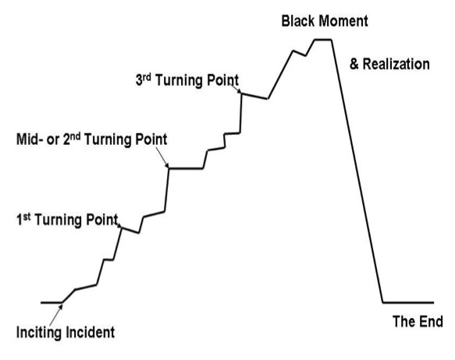
Turning Points are about Character as much as plot
No matter which plotting or writing method you choose, ask: do the turning points scene(s) include all turning point elements of plot AND emotion?
A good rule of thumb: 1 MAJOR turning point every 25,000 words
Could a kiss be a turning point? Why?

Slide 42
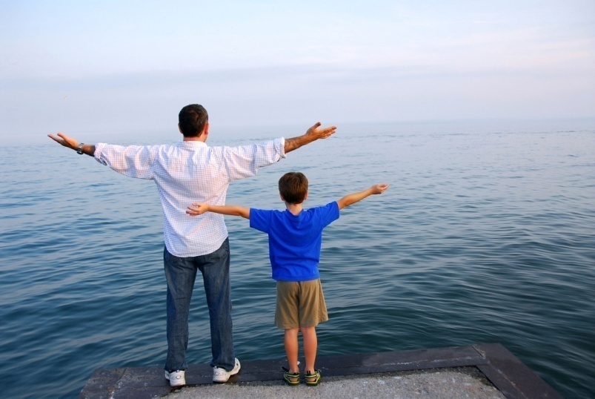
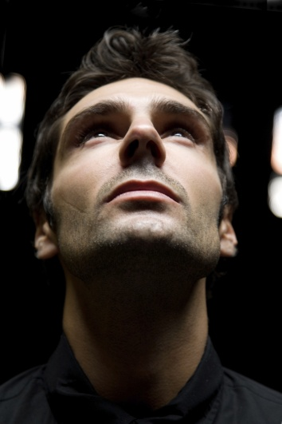


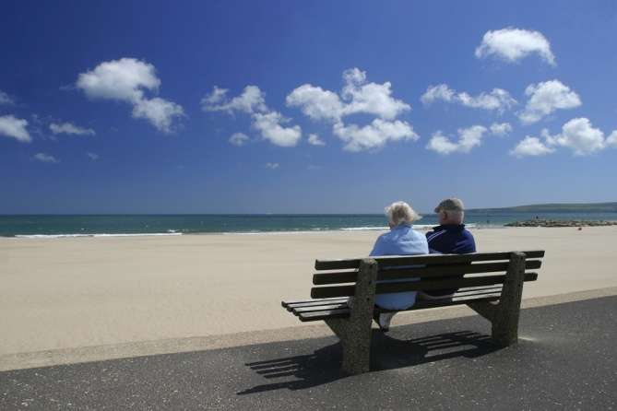

Make Your Characters Special
No matter what inspires the story, a story begins and ends with character

Slide 43
Strong Character Goals
Story is character.
  Character is the metaphor for a human being
  A character’s goals tell us a lot about their deep character. Ask WHY?
Character Sketch (see end of handout)
Make the Reader Care
  How much a character cares about
  his/her goal is in direct proportion to
  how much the reader will care (Laura DeVries)
  Long and Short-Range Goals
Goals
Plot
Conflict
Emotional Journey

Slide 44
Character vs. Characterization
Characterization - Sum total of observable traits
and qualities
  Age, sex, education, profession
  Introverted, extroverted, optimistic, pessimistic
Character - Deep true nature of your character, revealed by making choices under pressure
  Shift the character's reality
  Ask yourself what your character would NEVER do, and then figure out a way to make them do it.
  Each time you remove an obstacle, uncover one more.
The key question: WHY?
It always comes back to the same necessity: go deep enough and there is bedrock of truth, however hard. — May Sarton

Slide 45
Look beneath the surface
Favorite book or movie character
  What do they seem to be at the beginning of the story
  Who do we discover they are?
Name | Characterization | Character
James Bond | Lounge Lizard | Hero
Indiana Jones | Professor | Hero
Eve Dallas | Tough Cop | Caring and personally vulnerable
?
EXERCISE!

Slide 46
Duality of character
      Character's strength is their weakness

Slide 47

Braid Plot and Character
Whether you start with an idea, setting or scene.

Slide 48
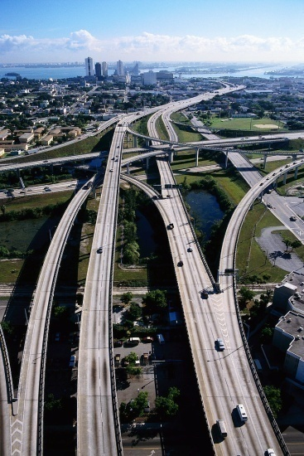
Plot ≠ Story
A Plot
  Is what happens
  Provides the action
  Provides motion
  Road it takes to get you there
A Story
  Is what it does to the ‘who’ it happens to.
  Provides the reactions
  Provides emotion
  Journey to truth
A Story…
  Recounts events that must be translated into feelings. It concerns . . . someone's reactions to what happens; his feelings; his emotions; his impulses; his dreams, his ambitions; his clashing drives and inner conflicts. Plunge the character into a pre-planned situation that challenges the part of him that cares, that threatens the thing he feels is important. — Dwight V. Swain, Techniques of the Selling Writer.

Slide 49
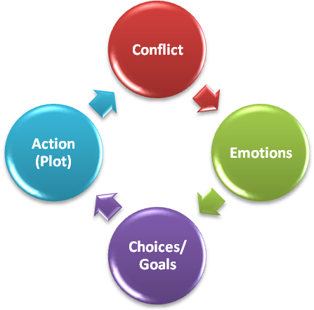
Emotions Connect Character and Structure
Why is this the only character for this story?
  Choose plot to exploit character
  Take it to another level: Villain personification of protagonist’s flaw
Actions don't drive the story. Actions drive emotions. Emotions drive the story.
  How the characters feel, create should change choices→plot
  Motivated Drama

Slide 50
Braid Overarching Message & Emotion
Step 1: Identify the protagonist's character flaw/internal conflict (based on emotion)
  _________________(protagonist) will [now or eventually] have to face and get past that he/she NEEDS/BELIEVES/
  FEARS________________________________________
  ______________________________________________.
Step 2: What does your character learn to overcome their flaw? = Your THEME!
Jazz Parker
Fears she can’t protect those she is
responsible for (those she loves)
because she didn’t in her past
The past does not dictate who I am. I am not my past…I am my own actions.
EXERCISE!

Slide 51
Show, Don’t Tell

Slide 52
Show, Don't Tell Emotions
Identify a key word from the Emotion Exercise
Write a paragraph showing this emotion without using the word (or a form of the word)
Sacrifice
Redemption
Joy
Betrayal
Forgiveness
EXERCISE!

Slide 53
Show Don’t Tell Through Narrative and Description
Significant Detail based on emotion, not research
Choose a setting. Choose two opposite emotions. Write a paragraph illustrating the emotions through significant details, without using the specific words (or a form of the word).
Hope
Despair
EXERCISE!

Slide 54
Show Don’t Tell Through Deep Point of View
The character tells the story, not the author
Imagery based on character
Finally reaching the landing, Deb slipped her key into the lock and opened the door. Ashley better have a good reason for being here and not at her Air Force Academy dorm where she belonged.
Her sister threw her textbook to the floor and jumped up from the beige corduroy couch like a gun had exploded in her ear.

Slide 55
Deep Point of View: Take 2
Luke Montgomery kept to the shadows, studying the surroundings for potential threats and quick exits. He preferred covert operations, but stealth wasn’t an option here. Even he couldn’t blend his six-feet-four-inch frame in this cracker box. Though he hadn’t set foot in the joint in a couple of years, too many people would recognize him.
A sharp rap of the cue ball hitting its target echoed like a gunshot over the raucous laughter. Nope, Sammy’s Bar hadn’t changed. Neither had the clientele.
Cops. And some of them were on the take.

Slide 56
Watch Out
!
    's/he felt,'
    's/he thought,'
    's/he saw,'
    's/he wondered,'
    's/he realized…

Slide 57
Be Aggressive During Revision

Slide 58
Revision: Big Stuff & Small Stuff
Read for pacing and compelling storytelling
  Dialogue is the best way to show character and emotion. Get rid of introspection if possible.
  Is there a "zinger" on every page?
  Is the POV character the right one?
  Can you tell whose POV character it is on every page?
  Symptoms of Lack of Conflict
    Is there repetitious dialogue? (no conflict development)
    Tack on other issues
  Have I braided internal and external conflict (do they lead to each other?
Three Versions (Activate the story (from telling to showing)

Slide 59
First Draft - The Cerebral Version
Strengths
Tension
Vivid Imagery
Sympathy
Weakness
Distance
Telling
Damn Richard St. James to hell. He'd slaughtered them--he'd slaughtered them all.
Jaw clenched with fury, Jonathan Price urged the horse he'd commandeered at the last posting stop forward. His hands and cloak were soaked with blood. He had to get home. He could only pray he wasn't too late.
The sky billowed with black clouds, and little light illuminated the old Roman road he raced down. His heart pounded, and agony ripped through his chest.
He'd witnessed carnage during the war. Waterloo had been a bloodbath, but Anne should never have witnessed the massacre she'd seen tonight. Until a few hours ago, his fiancée had known nothing of the brutality of man.
St. James had changed her--forever. The bastard.
Anne's family--murdered in cold blood. All of them, down to her young sister barely out of the crib.
Jonathan's stomach wretched at the memory of the Cavanaugh's laid out in front of their home like some gruesome message, their throats torn open as if an animal had feasted. But even that hadn't shredded his heart like Anne's mewing cries as he'd cradled her in his arms. He just prayed her family in York would be able to heal her mind, even if her heart were forever broken.

Slide 60
Second Draft
Strengths
Tension
Imagery
Sympathy
More Personal
Weakness
Distance
Telling
Happened in past
Damn Richard St. James to hell.
He'd slaughtered them. He'd slaughtered them all save one.
A mist of night smoldered the burning remains of the Price family home, and Jonathan blinked through the soot streaking the land that had once been the family's pride and joy. He breathed in, willing the nausea churning his stomach to not desecrate this place. They deserved better.
Jaw clenched, he forced himself to stare into their sightless eyes one by one. His father, his mother, his young sister. Lined up in a row, their bodies were darkened with ash, the only color, the red seeping from their shredded throats.
But that wasn't the worst of it. St. James hadn't just killed them--he'd tortured and humiliated them. Jonathan couldn't bear the thought of what the bastard had done. His young brother, Edward, by happenstance still at Eton, would never know, Jonathan vowed.
With care, he covered his young sister's bare body, and concealed his mother's naked torso with her decimated gown. As for Jonathan's father, St. James had emasculated him, the blood soaking his pants.
Deep fury, like Jonathan had never imagined, even on the bloodiest Waterloo battlefield, skewered his gut like a thousand splinters of glass.

Slide 61
Activated Draft
Strengths
Active
Immed.
Showing
Editor Requested
Weakness
A few telling phrases
Small Stuff Editing
Jonathan Price hurled himself through the fiery hallway, clutching his sister’s limp body close to his heart. "Don't give up, Elizabeth." His desperate plea was swallowed by the hellish roar of the inferno crackling around him. Blistering heat seared his hands and face. Black roiling smoke scorched his lungs.
Maddened with grief, he kicked the flaming debris from the doorway and burst into the rainy night. He staggered across the muddy yard, and coughing and hacking, fell to his knees before laying his sister on the sodden grass.
The fire illuminated the vicious wound on her neck, and then her sightless eyes.
Dear God, what manner of beast had done this? Torn the very skin from her throat, killed her with no mercy?
He whirled toward Price Manor. The blaze erupted from every window and door, scarlet serpents of flame devouring all in their path, engulfing everything.
Where was the rest of his family? The servants, the butler, even the scullery maid? Had they escaped or had the beast killed them, too?
"Please." He raced back toward the house, only to be grabbed and flung to the cobblestones. Dazed and gasping for air, Jonathan peered up at the cloaked shape looming over him.
"You cannot save anyone, you fool. They're all dead. Your family, and Lady Anne's as well."

Slide 62
Activate Your Writing
Use powerful, picturing-forming and image-making words
Evoke emotions with your word choices
Excuse me, your research is showing….
Interpreting scenes through the genre and the viewpoint characters' emotions
Deep Point of View – critical to active and emotional writing

Slide 63
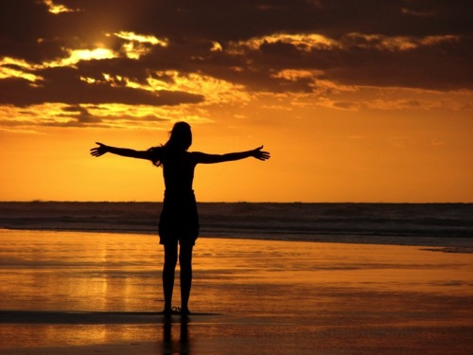
Conclusion
Trust your instincts
Find Your Own Process and Don't Edit Out the Passion
  Let your Voice Shine Through.
  It's YOUR story, but always ask WHY?!
  Ray Bradbury says, "There is only one type of story in the world--YOUR story."

Slide 64
Q&A and Drawing
    www.robinperini.com

Slide 65
Backups

Slide 66
VERSION 1
(The Cerebral Version)
"Remind me again why you thought spending Thanksgiving with them would be a good idea?" Josh Wentworth grumbled, as he flipped on the windshield wipers to batten away the snowflakes that were coming down faster. The SUV curved through the Denver traffic and he took the Quincy exit. "It'll be a disaster. It always is. I don't want Joshua's first Thanksgiving to be more like a root canal than a celebration.”
Emily Wentworth shot her husband a frustrated glance. "Our one-month old won't be warped. Besides, your parents deserve to get to know their new grandson." An overwhelming sense of rightness filled her as she glanced at the baby in the backseat, his cheeks rosy with warmth as he slept. "With Ryan deployed overseas, your family's all he's got.”

Slide 67
VERSION 2
(Honing in on More Important Details)
Eric Wentworth was dying. He didn't have to see the stop sign's shaft penetrating his chest or the blood pulsing from the wound. Strange, though. He felt no pain, but he could feel his life slipping away as surely as the ravaging winter wind whistled through his crumpled car.
He wasn't ready to die. Not yet. He had a wife who loved him and a new baby boy he'd just met. He couldn't leave them alone and unprotected.
"Eric?”
He struggled to turn his head toward his wife's weak cry.

Slide 68
VERSION 3 – Final Version
(Active Writing Utilizing Deep Point of View)
This is the prologue that won the Golden Heart in 2011
and sold to Harlequin Intrigue.
Icy wind howled through the SUV's shattered windshield, spraying glass and freezing sleet across Eric Wentworth's face. He struggled in and out of consciousness. Flashes of memory struck. Oncoming headlights on the wrong side of the road. Skidding tires on black ice. The baby's cries. Emily's screams.
Oh, God.
Why couldn't he focus? Above the wind, he heard only silence, then an ominous gurgling sound from his lungs. He shifted his head slightly to check on his wife, and a knifelike pain seared his neck. He stopped, staring in horror at the shaft of metal guardrail penetrating his chest. Blood pulsed from the wound, but he couldn't feel it. He couldn't feel anything.
Eric was dying. And it was no accident. He hadn't taken the threats seriously, hadn't told Emily what he'd done. Why they were all in danger.

