Slide 1
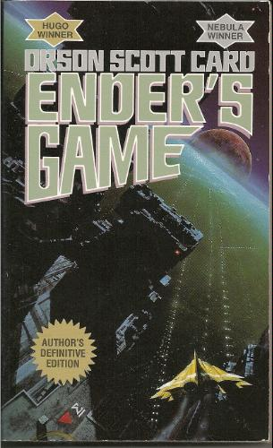
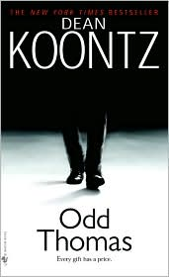
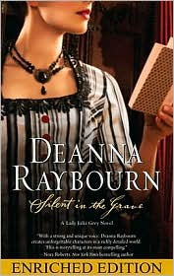
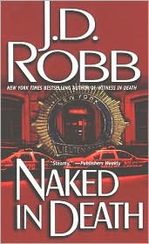
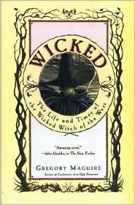
Take a Look at These Openings…
What makes them work?

Slide 2
Dialogue Only Ender’s Game by Orson Scott Card
"I've watched through his eyes, I've listened through his ears, and I tell you he's the one. Or at least as close as we're going to get."
"That's what you said about the brother."
"The brother tested out impossible. For other reasons. Nothing to do with his ability."
"Same with the sister. And there are doubts about him. He's too malleable. Too willing to submerge himself in someone else's will."
"Not if the other person is his enemy."
"So what do we do? Surround him with enemies all the time?"
"If we have to."
"I thought you said you liked the kid."
"If the buggers get him, they'll make me look like his favorite uncle."
"All right. We're saving the world, after all. Take him."

Slide 3
Internal Dialogue Dance with the Devil by Sherrilyn Kenyon
New Orleans, The Day After Mardi Gras
Zarek leaned back in his seat as the helicopter took off. He was going home to Alaska.
No doubt he would die there.
If Artemis didn't kill him, he was sure Dionysus would. The god of wine and excess had been most explicit in his displeasure over Zarek's betrayal and in what he intended to do to Zarek as punishment.
For Sunshine Runningwolf's happiness, Zarek had crossed a god who was sure to make him suffer even worse horrors than those in his human past.
Not that he cared. There wasn't much in life or death that Zarek had ever cared about.

Slide 4
First Person Narrative Odd Thomas by Dean Koontz
My name is Odd Thomas, though in this age when fame is the altar at which most people worship, I am not sure why you should care who I am or that I exist.
I am not a celebrity. I am not the child of a celebrity. I have never been married to, never been abused by, and never provided a kidney for transplantation into any celebrity. Furthermore, I have no desire to be a celebrity.
In fact I am such a nonentity by the standards of our culture that People magazine not only will never feature a piece about me but might also reject my attempts to subscribe to their publication on the grounds that the black-hole gravity of my noncelebrity is powerful enough to suck their entire enterprise into oblivion.

Slide 5
First Person Internal Dialogue Hissy Fit by Mary Kay Andrews
If it had not been for my fiance's alcoholic cousin Mookie I feel quite sure that my daddy would still be a member in good standing at the Oconee Hills Country Club. But Mookie can't drink hard liquor. She can drink beer and wine all day and all night and not bat an eyelash, but give her a mai-tai or, God forbid, a margarita, and you are asking for trouble.
It was my rehearsal dinner, which the Jernigans were hosting, and I was the bride-to-be, so I don't believe I should have been the one responsible for keeping a grown woman and mother of two away from the margarita machine, even if she was one of the bridesmaids.

Slide 6
Third person Internal Dialogue Naked in Death by J.D. Robb
She woke in the dark. Through the slats on the window shades, the first murky hint of dawn slipped, slanting shadowy bars over the bed. It was like waking in a cell.
For a moment, she simply lay there, shuddering, imprisoned, while the dream faded. After ten years on the force, Eve still had dreams.
Six hours before, she'd killed a man, had watched death creep into his eyes. It wasn't the first time she'd exercised maximum force, or dreamed. She'd learned to accept the action and the consequences.
But it was the child that haunted her. The child she hadn't been in time to save. The child whose screams had echoed in the dreams with her own.

Slide 7
Omnicient Wicked: The life and Times of the Wicked Witch of the west by Gregory Maguire
On the Yellow Brick Road
A mile above Oz, the Witch balanced on the wind's forward edge, as if she were a green fleck of the land itself, flung up and sent wheeling away by the turbulent air. White and purple summer thunderheads mounded around her. Below, the Yellow Brick Road looped back on itself, like a relaxed noose. Though winter storms and the crowbars of agitators had torn up the road, still it led, relentlessly, to the Emerald City. The Witch could see the companions trudging along, maneuvering around the buckled sections, skirting trenches, skipping when the way was clear. They seemed oblivious of their fate. But it was not up to the Witch to enlighten them.

Slide 8
First person Silent in the grave by Deanna Raybourn
London 1886
Other sins only speak; murder shrieks out.—John Webster, The Duchess of Malfi
To say that I met Nicholas Brisbane over my husband's dead body is not entirely accurate. Edward, it should be noted, was still twitching upon the floor.
I stared at him, not quite taking in the fact that he had just collapsed at my feet. He lay, curled like a question mark, his evening suit ink-black against the white marble of the floor. He was writhing, his fingers knotted.
I leaned as close to him as my corset would permit.
"Edward, we have guests. Do get up. If this is some sort of silly prank—"
"He is not jesting, my lady. He is convulsing."

